Slide 1

Machine Learning
An Introduction
The Cloud Data Platform for Insights-Driven Enterprises

Slide 2
Agenda
Categories of Machine Learning Algorithms
Use Cases
Machine Learning Life Cycle

Slide 3
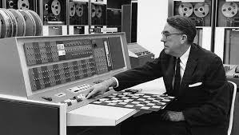
Machine Learning
Arthur Samuel (1959) – Machine Learning: Field of Study that gives the ability to learn without being explicitly programmed. - Checker Programmer
Notes:
We are touched by Machine Learnning everyday. This is nothing new to us. We have been at this problem since the time of compute.

Slide 4
From data to decisions and actions
Data
Recommendations
What should I do?
Decision
Action
Decision automation
Decision support
Predictions
What will happen?
Interactive dashboards
Why did it happen?
Static reports
What happened?
Manual process
Value
Notes:
Azure ML aims to transform your data in to an intelligent action

Slide 5
Categories of Machine Learning
Supervised
Train with Labelled Data and then you predict
Most Success
Unsupervised
Understanding the data by finding hidden patterns
Reinforcement Learning
Animal Behvior
Success with Games, Robotics, Simulations

Slide 6
Machine Learning
Supervised
Regression
Classification
Unsupervised
Clustering
Recommendation
Outlier detection
Reinforcement Learning
Notes:
Regression
- E.g. Predicting house prices based on weather data and square feet. Checking what the price of your house would be
Classification
- Prediction of a Malignant or Benign
Unsupervised learning
- clustering
- gene data
- image processing
- 2d to 3d
- social network analysis
- market segmentation
- astronomical data analysis

Slide 7
Supervised Learning
ID | Total$ | Age | City | Target
101 | 200 | 25 | SF | 2
102 | 350 | 35 | LA | 2
103 | 25 | 15 | LA | 1
… | … | … | … | 1
 |  |  |  | 1
 |  |  |  | 2
Model
ID | Total$ | Age | City
105 | 234 | 22 | NYC
106 | 112 | 67 | BOS
Target
Labeled dataset
Test data
Infer a target function from labeled dataset
Example: classification, regression
Notes:
Supervised learning (aka predictive modeling)
Here we have a “labled dataset” that used to “learn” the predictive model. Our target function (in this diagram a label of 1 or 2 – classification) needs to be defined based on the problem we are trying to solve. For example: spam or no-spam.
After training the model is completed, we get a “model” which is essentially a representation of the learned function (usually very small in size).
When we want to “predcit” or “Score”, then we apply the model to one or more instances (rows) and ask the model to “predict” the target variable (in this case 1 or 2).

Slide 8
Unsupervised Learning
ID | Total$ | Age | City
101 | 200 | 25 | SF
102 | 350 | 35 | LA
103 | 25 | 15 | LA
… | … | … | …
Model
Naturally occurring
hidden structure
No labels
Identify naturally occurring patterns in data
Example: clustering
Notes:
Unsupervised learning is broad category of various techniques. What is shown here is mostly “clustering”
But generally, the difference from supervised learning is that with unsupervised you don’t have a labeled dataset or a training set. You just have feature vectors and you’re trying to detect “naturally occurring patterns”.

Slide 9
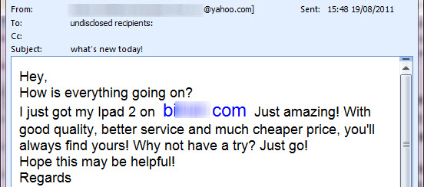
Example: Email Spam Detection
2 classes: Spam or Not-Spam
Features: words that appear (or not) in the email text
Notes:
A common example of supervised learning is: detecting spam.
We build a feature matrix where each row represents an email message in our training set, and our target function includes 2 classes: spam or “no spam”
The features are words or sequences of words that might appear or not-appear in the text. (e.g., “buy stock”)

Slide 10
Regression Analysis
ID | Age | City | Target
101 | 25 | SF | $200
102 | 35 | LA | $350
103 | 15 | LA | $25
… | … | … | …
Model
Labeled
dataset
ID | Age | City | Target
104 | 17 | NYC | ?
Test data
Techniques: linear regression, decision trees, etc
Many more
Notes:
Regression is similar to classification, but instead of predicting a class or category, we predict a continuous value. For example, predict a risk score for a loan based on various features about the loan and/or the person requesting the loan.
Like with classification, there are many different algorithms available, some are noted in the slide.

Slide 11
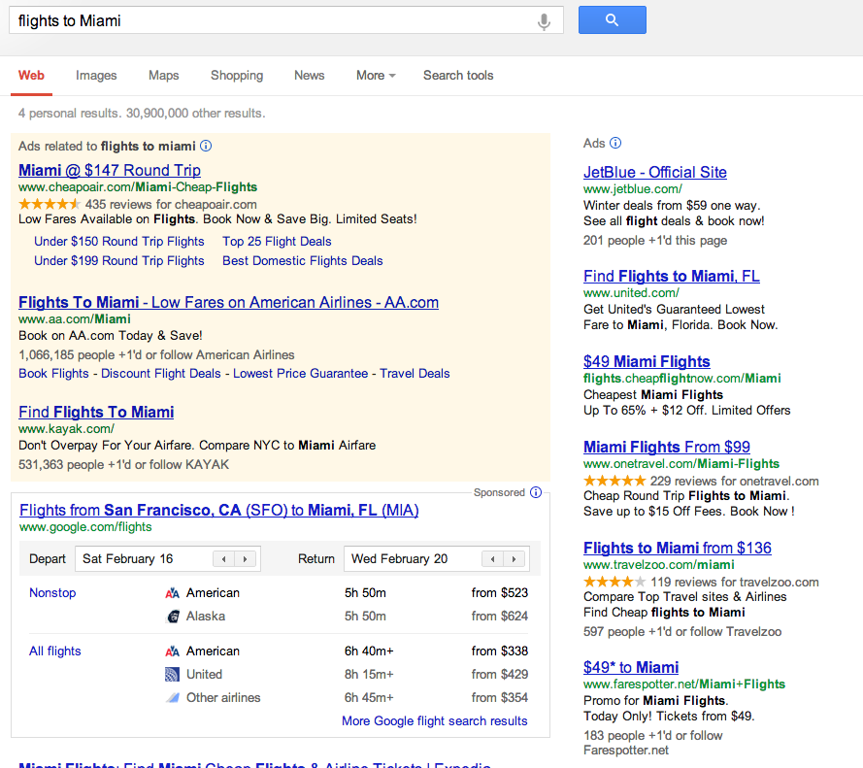
Regression Example: Ad Click Through Rate (CTR) Prediction
Rank = bid * CTR
Predict CTR for each ad to determine placement, based on:
Historical CTR
Keyword match
Etc…
Notes:
Ad Click through rate prediction
In search advertising, ads are ranked based on BID * CTR (companies like Google, MSFT, Yahoo implement this).
The goal here is to predict for a given search query and every possible ad, what would be the CTR if we put that ad on the results page.

Slide 12
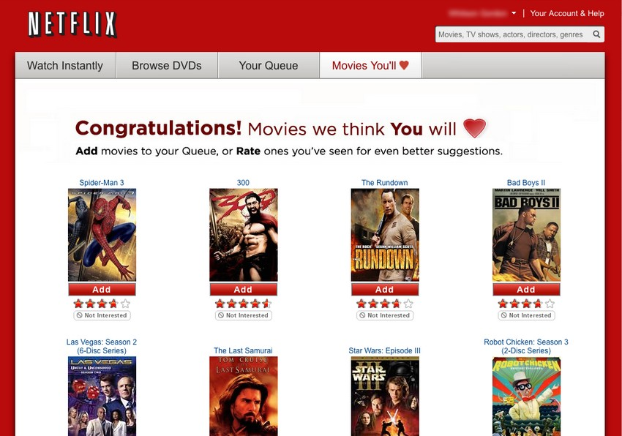
Example: Netflix Movie Recommendations
Notes:
Poster child exmaple: netflix.
Techniques: collaborative filtering is most common (Alternative least squares or ALS, item-based, user-based)
In practice, usually recommendations are store in a real-time DB (e.g., HBASE) and retreive/displayed when a user enters the website.

Slide 13
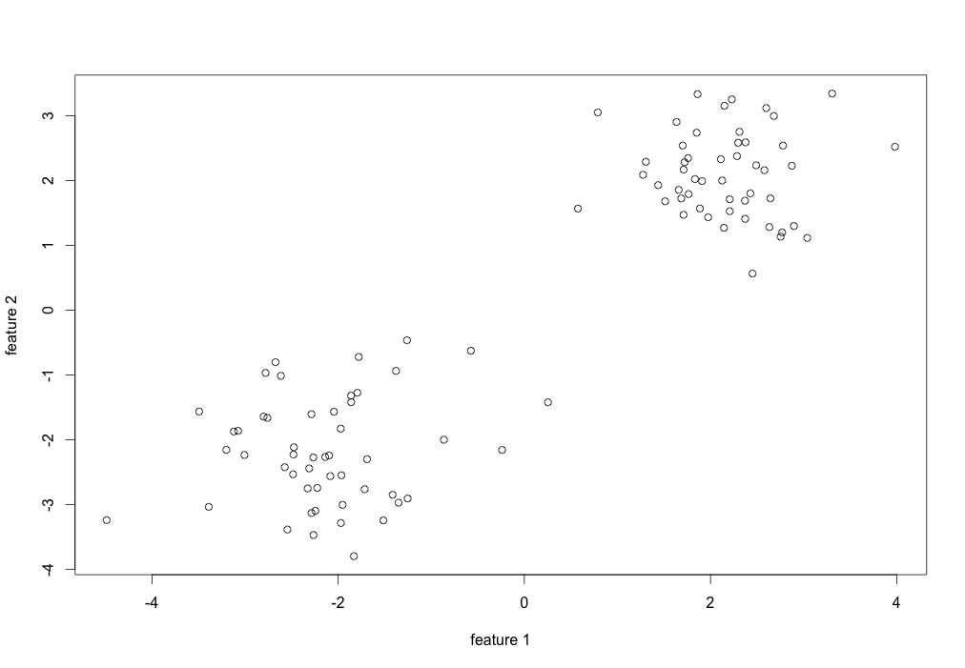
Clustering
Notes:
In clustering, we have various points available, but no labels.
As you can see in this slide, points all look the same.
We are trying to figure out if they “cluster” together in some way.

Slide 14
Recommendation Engine
Harry potter
X-Men
Hobbit
Argo
Pirates
Harry potter
X-Men
Hobbit
Argo
Pirates
101
102
103
104
105
…
5 | 2 | 4 | ? | ?
? | ? | 5 | 2 | ?
1 | 2 | ? | ? | 3
101
102
103
104
105
…
5 | 2 | 4 | 1 | 3
4 | 1 | 5 | 2 | 3
1 | 2 | 4 | 1 | 3
Notes:
Recommendation engines are very popular, used by companies such as Amazon, Netflix, Google and others
The main concept is to recommend products or services to a user based on their history of consumption and that of OTHER USERS SIMILAR TO THEM.
In this example (following the netflix model):
On the left is our user/product matrix. For example, User 101 has rated Harry Potter with 5 starts, X-Men with 2 stars and Hobbit with 4 starts. She has not rated Argo or Pirates, so these cells are empty (marked as question marks here)
On the right is our goal to complete the matrix and predict what the rating would be for this user had they seen and rated that movie.

Slide 15
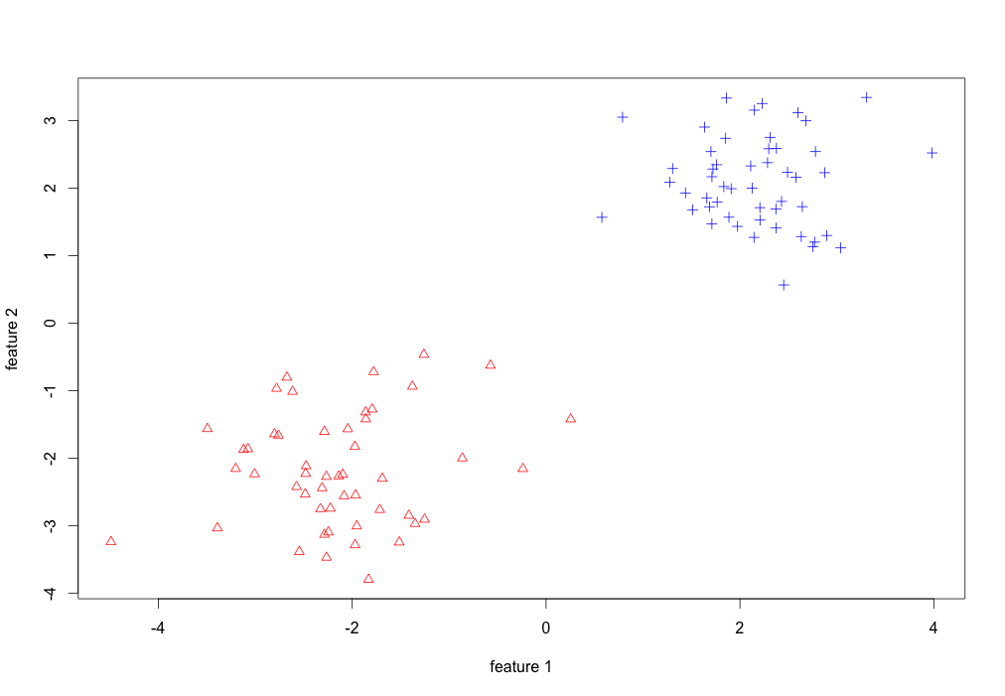
Detecting Natural Groups
Notes:
The goal is to identify cluster. Here in this example, we found 2 clusters: red and blue.

Slide 16
Determining Class Labels
N Variables
Some techniques:
Kmeans
Spectral clustering
DB-scan
Hierarchical clustering
ID | Total$ | Age | City | Class
101 | $200 | 25 | SF | 2
102 | $350 | 35 | LA | 2
103 | $25 | 15 | LA | 1
… | … | … | … | 1
 |  |  |  | 1
 |  |  |  | 2
 |  |  |  | 2
 |  |  |  | 2
Notes:
Most common technique is K-means. But there are some others like Spectral, DB-scan, etc.
It’s a lot of art to know which technique to use, and determine if you have reached a good outcome. Evaluating quality of the outputs of clustering requires a lot fo work, good intuition and understanding of the task and the business context.,
Also, you need to determine the number of clusters upfront; not easy, and sometimes the business context helps.
In data mining, hierarchical clustering (also called hierarchical cluster analysis or HCA) is a method of cluster analysis which seeks to build a hierarchy of clusters.
Density-based spatial clustering of applications with noise (DBSCAN) is a data clustering algorithm proposed by Martin Ester, Hans-Peter Kriegel, Jörg Sander and Xiaowei Xu in 1996.[1] It is a density-based clustering algorithm because it finds a number of clusters starting from the estimated density distribution of corresponding nodes. DBSCAN is one of the most common clustering algorithms and also most cited in scientific literature.[2] OPTICS can be seen as a generalization of DBSCAN to multiple ranges, effectively replacing the ε parameter with a maximum search radius.

Slide 17
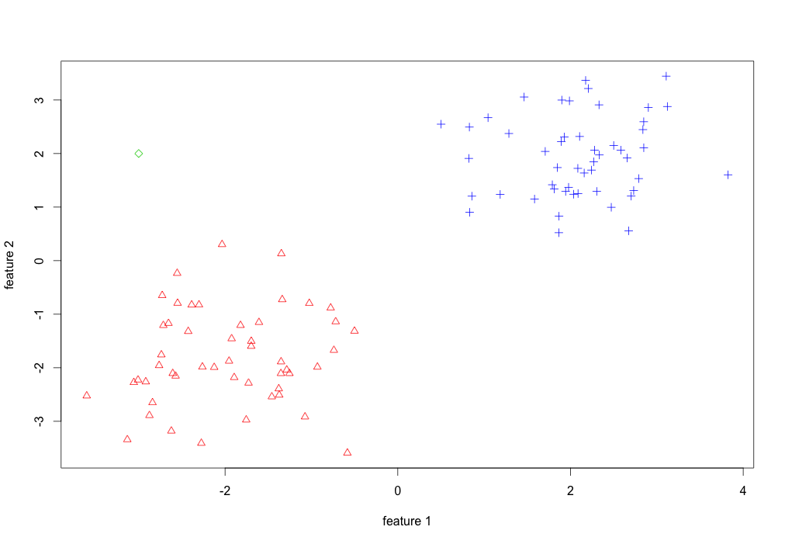
Detecting Outliers
Outlier point
Notes:
In this example, the green point seems to be an anomaly.

Slide 18
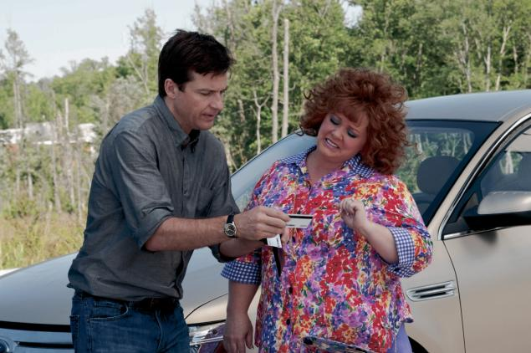
Example: Credit Card Fraud Detection
Notes:
Example from movie: “IDENTITY THEFT”

Slide 19
Affinity Analysis
Item 1
Item 2
Item 3
Item 4
Item 5
…
Item 1
Item 2
Item 3
Item 4
Item 5
…
Tx 1
Tx 2
Tx 3
Tx 4
Tx 5
…
Y | N | N | Y | N
Y | N | N | Y | N
Y | Y | N | Y | N
N | N | Y | Y | Y
Tx 1
Tx 2
Tx 3
Tx 4
Tx 5
…
Y | N | N | Y | N
Y | N | N | Y | N
Y | Y | N | Y | N
N | N | Y | Y | Y
Goal: identify frequent itemset
Techniques: FP Growth, Apriori
Notes:
Also called “association rules” or “market basket analysis”
The goal is to look at sets of transactions and identify pairs or triple or quads etc of items that tend to be purchased together as a group.
In this example, item #1 and item #4 tend to show that pattern. This is highlighted in red in the second matrix.

Slide 20
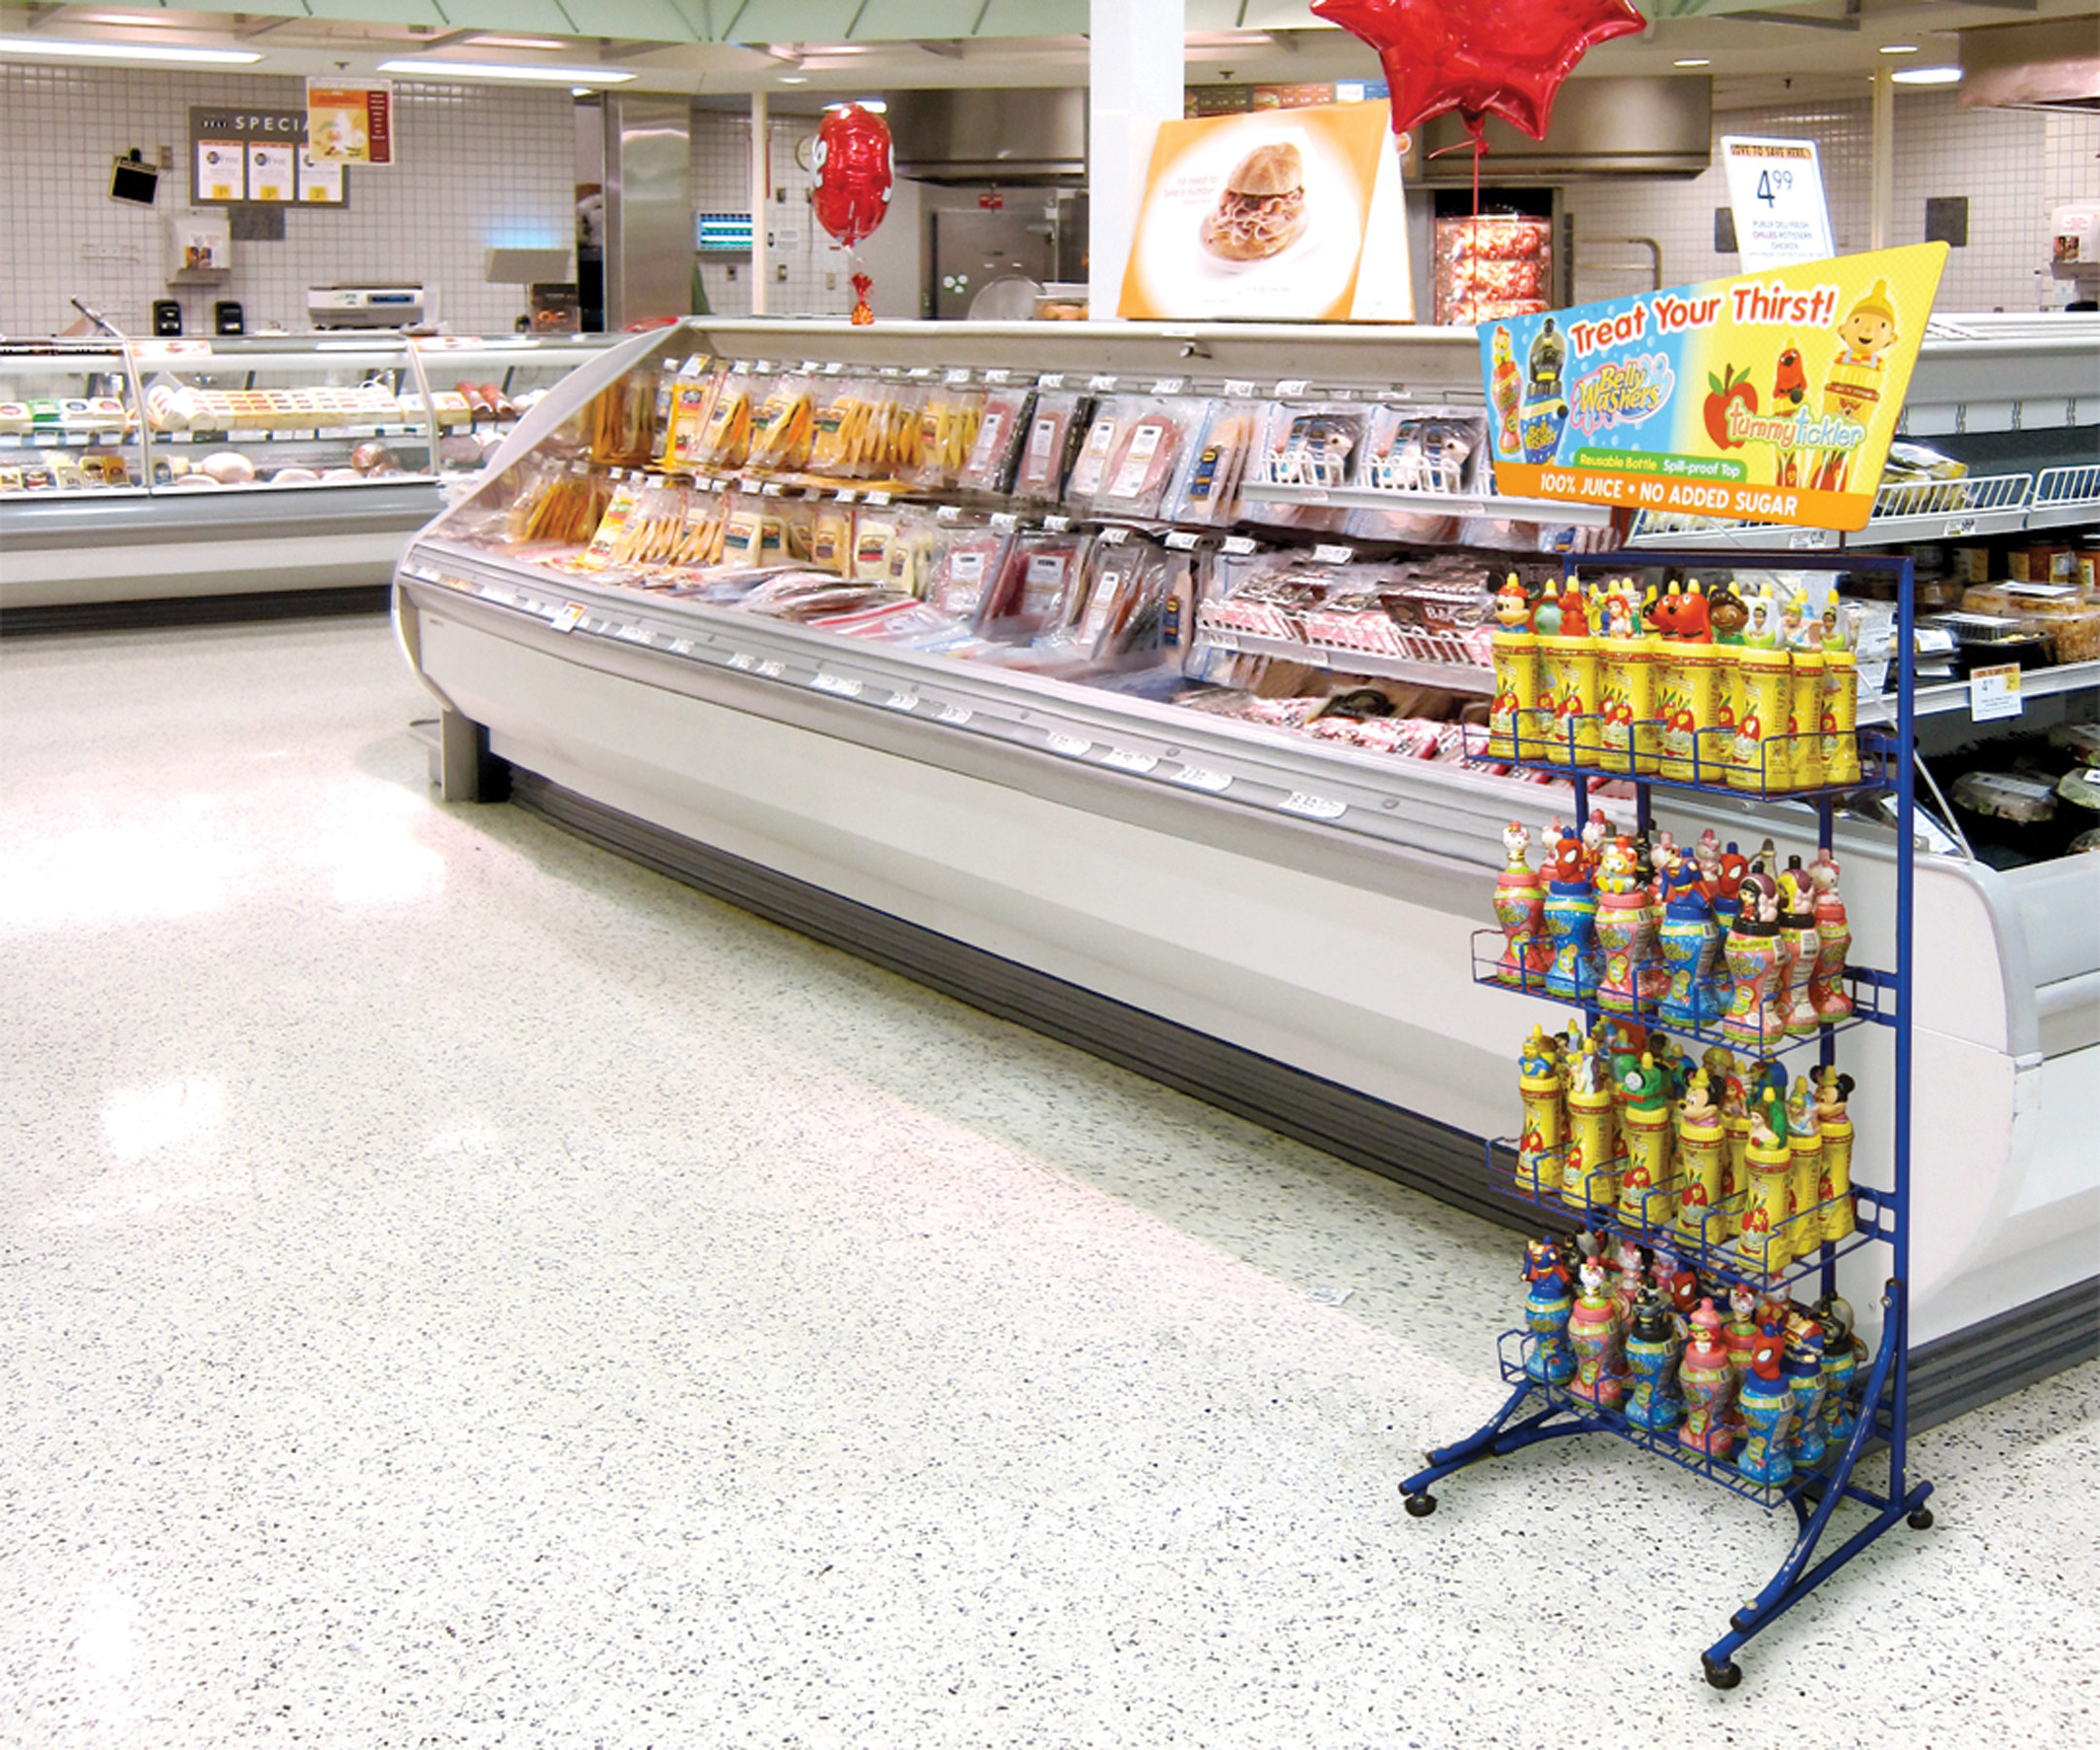
Example: Market Basket Analysis
Use affinity analysis for
store layout design
Coupons
Notes:
This is mostly used in retail, e.g. grocery stores
The output of the market basket analysis is used in a variety of ways, most common are:
Design store layout so that items that tend to be purchased together are close to each other
Send out a coupon for item 1 in the itemset, resulting in customers buying items 2, 3, and 4 (at a higher price).

Slide 21
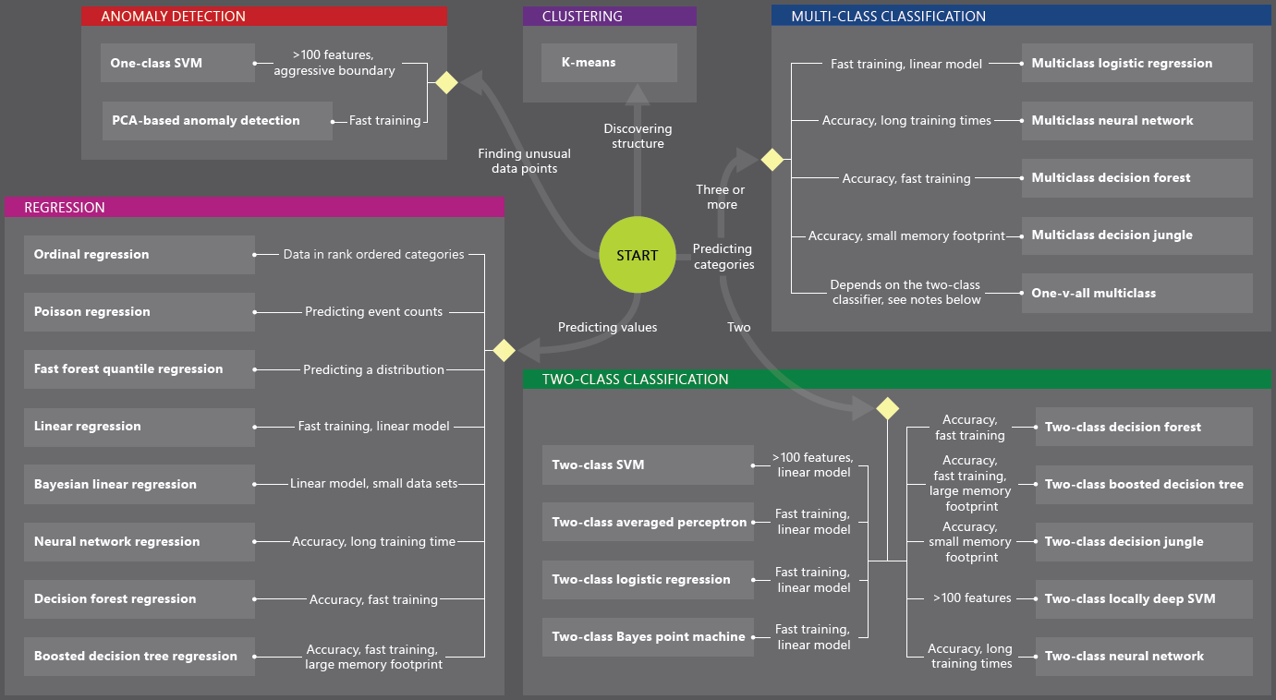
Use Cases - Algorithms

Slide 22
Sample Machine Learning – Life Cycle
Deploy as Web Service
Provision Workspace
Build ML Model
Deploy Model as a Web Service
Publish an App
Get/Prepare Data
Get Qubole Subscription
Create Cluster
Evaluate Model Results
Build/Edit Experiment
Integrate with App/Analytics
Create/Update Model
Publish the model
Examine the Predictions / Use more production data to fine tune Model

Slide 23
Machine Learning - Personas
ML Algorithm
Computer Scientist
ML Studio
Data Scientist
ML Operationalization
IT Professional
ML APIs Marketplace
ISVs & Developers

Slide 24
Steps to Build a Machine Learning Solution
1
Problem Framing
2 Get/Prepare Data
3
Develop Model
4
Deploy Model
5
Evaluate / Track Performance
3.1
Analysis/ Metric definition
3.2
Feature Engineering
3.3
Model Training
3.4
Parameter Tuning
3.5
Evaluation

Slide 25

Example use cases
Finance and risk
Sales and marketing
Customer and channel
Operations and workforce
Revenue Forecasting
Sales forecasting
User segmentation
Agent allocation
$$$
Portfolio optimization
Demand forecasting
Personalized offers
Warehouse efficiency
Investment modelling
Sales lead scoring
Product recommendation
Smart buildings
$$$
Fraud detection
Marketing mix optimization
Predictive maintenance
Risk management
Supply chain optimization
Notes:
Many examples of predictive analytics can be found literally everywhere today in our society:
Spam/junk email filters These are based on the content, headers, origins, and even user behaviors (for example, always delete emails from this sender).
Mortgage applications Typically, your mortgage loan and credit worthiness is determined by advanced predictive analytic algorithm engines.
Various forms of pattern recognition These include optical character recognition (OCR) for routing your daily postal mail, speech recognition on your smart phone, and even facial recognition for advanced security systems.
Life insurance Examples include calculating mortality rates, life expectancy, premiums, and payouts.
Medical insurance Insurers attempt to determine future medical expenses based on historical medical claims and similar patient backgrounds.
Liability/property insurance Companies can analyze coverage risks for automobile and home owners based on demographics.
Credit card fraud detection This process is based on usage and activity patterns. In the past year, the number of credit card transactions has topped 1 billion. The popularity of contactless payments via near-field communications (NFC) has also increased dramatically over the past year due to smart phone integration.
Airline flights Airlines calculate fees, schedules, and revenues based on prior air travel patterns and flight data.
Web search page results Predictive analytics help determine which ads, recommendations, and display sequences to render on the page.
Predictive maintenance This is used with almost everything we can monitor: planes, trains, elevators, cars, and yes, even data centers.
Health care Predictive analytics are in widespread use to help determine patient outcomes and future care based on historical data and pattern matching across similar patient data sets.

Slide 26


